Slide 1
Problem Statement : Enhancing Coastal Security – PS8 Team Name : Team_Stark Team Members : Dhinesh R, Aditya Mandil, Wei Ching, Tran Dang Phuong, Rendy, Banchong Mentors : Wida Susanty Haji Suhaili, Teng Seavpor Team Manager : Ajay Rajawat
Project - SOLAS
Project Objective
Providing a smarter system which would enhance the costal security and automatically categorize vessels as registered and unregistered moving within 50 NM of the coast providing vital information such as vessel name, owner’s name, status and live tracking of the ship all integrated into smart dashboard with periodic alerts.
ASEAN – India Hackathon Team 19

Slide 2
Idea Description:
The system involves developing a hardware unit and a web application. The hardware unit is a custom designed PCB module which will be enclosed in a ABS non-corrosive, water & dust proof durable anti-static plastic box.
The hardware unit can be retrofitted to any vessel irrespective of size which will tether the vessel’s info & geo location using GPS and GSM module to a centralised server.
The web application includes features like live tracking of any vessel, satellite view, segregating registered and unregistered ships and geo tagging unregistered ships specifically.
Any vessel in emergency having the hardware unit installed will also be alerted in the application dashboard.
The key features of hardware unit includes emergency SOS button, tamper detection and sending alerts and backup power using solar cell.
Technology Used:
Python based Web Application
EasyEDA for PCB designing
Firebase Server for fetching GPS coordinates from hardware unit
Fritzing for circuit design
Python IOT sensors
AWS for cloud service

Slide 3
Hardware Unit:
Emergency SOS Button
Completely Tamperproof
Cannot be switched off
Emergency Backup power supply
IP55 Waterproof & Weatherproof
Blackbox for ships
IMO Standard HW unit
Iridium 9603 based satellite communication chip
24/7 live tracking
Solar powered
On board GSM for communication within 12 kms
Service technician mobile app for easy installing of this device
Policy for installing hardware unit in vessel
Software Dashboard:
Simple and Neat UI
Easy to use
Radar or map view of coast
Dedicated search option for registered ships
Automatic categorization of ships up to 50 NM
Unusual high speed detection
Provision for importing API of various other AIS applications
Periodic alerts about unregistered ships
Automatically finds status of ships
All details provided by AIS are available in a single window with more reliability
Course towards naval base detection

Slide 4
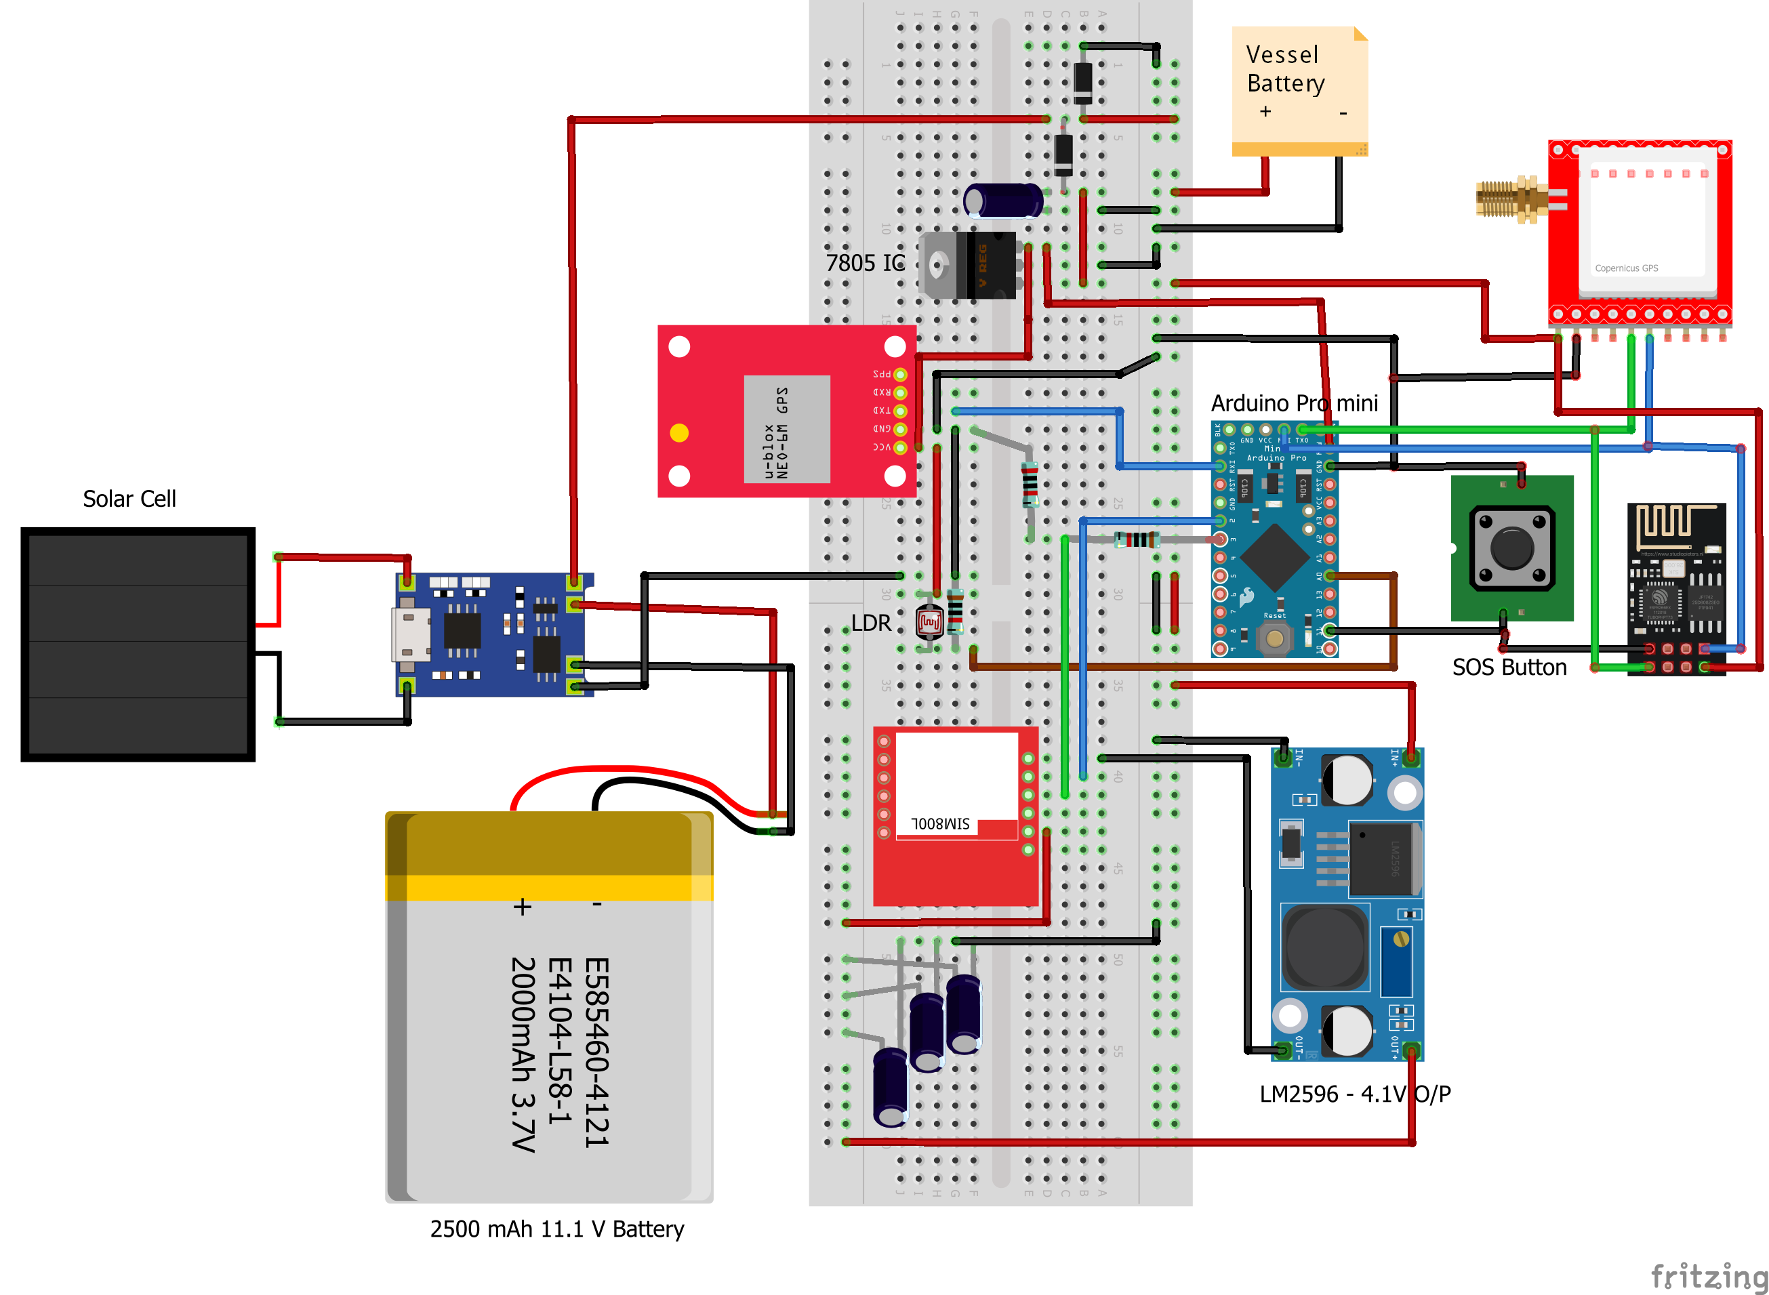
Circuit - Breadboard

Slide 5
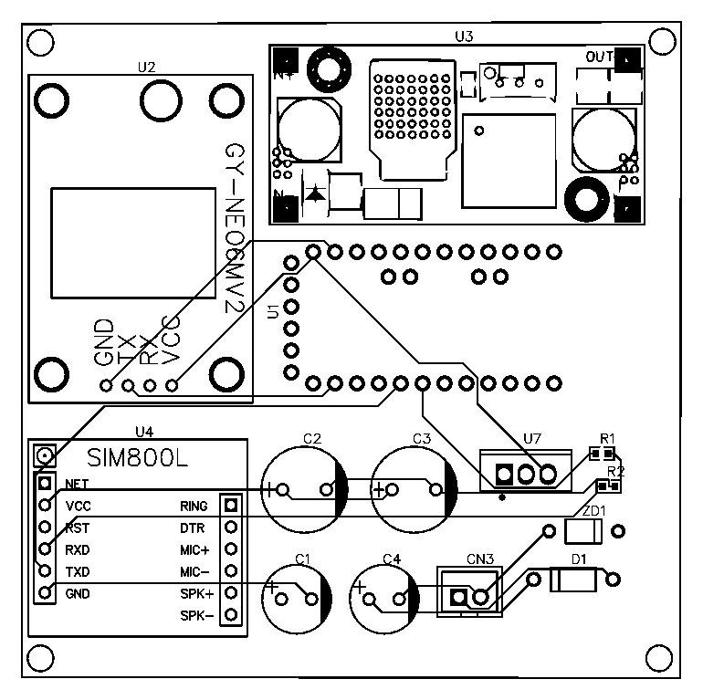
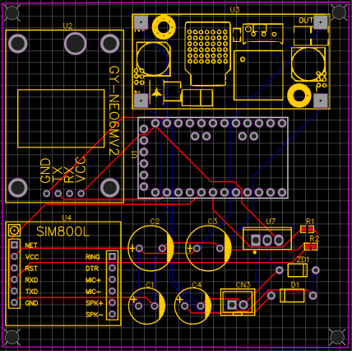
Circuit - PCB

Slide 6
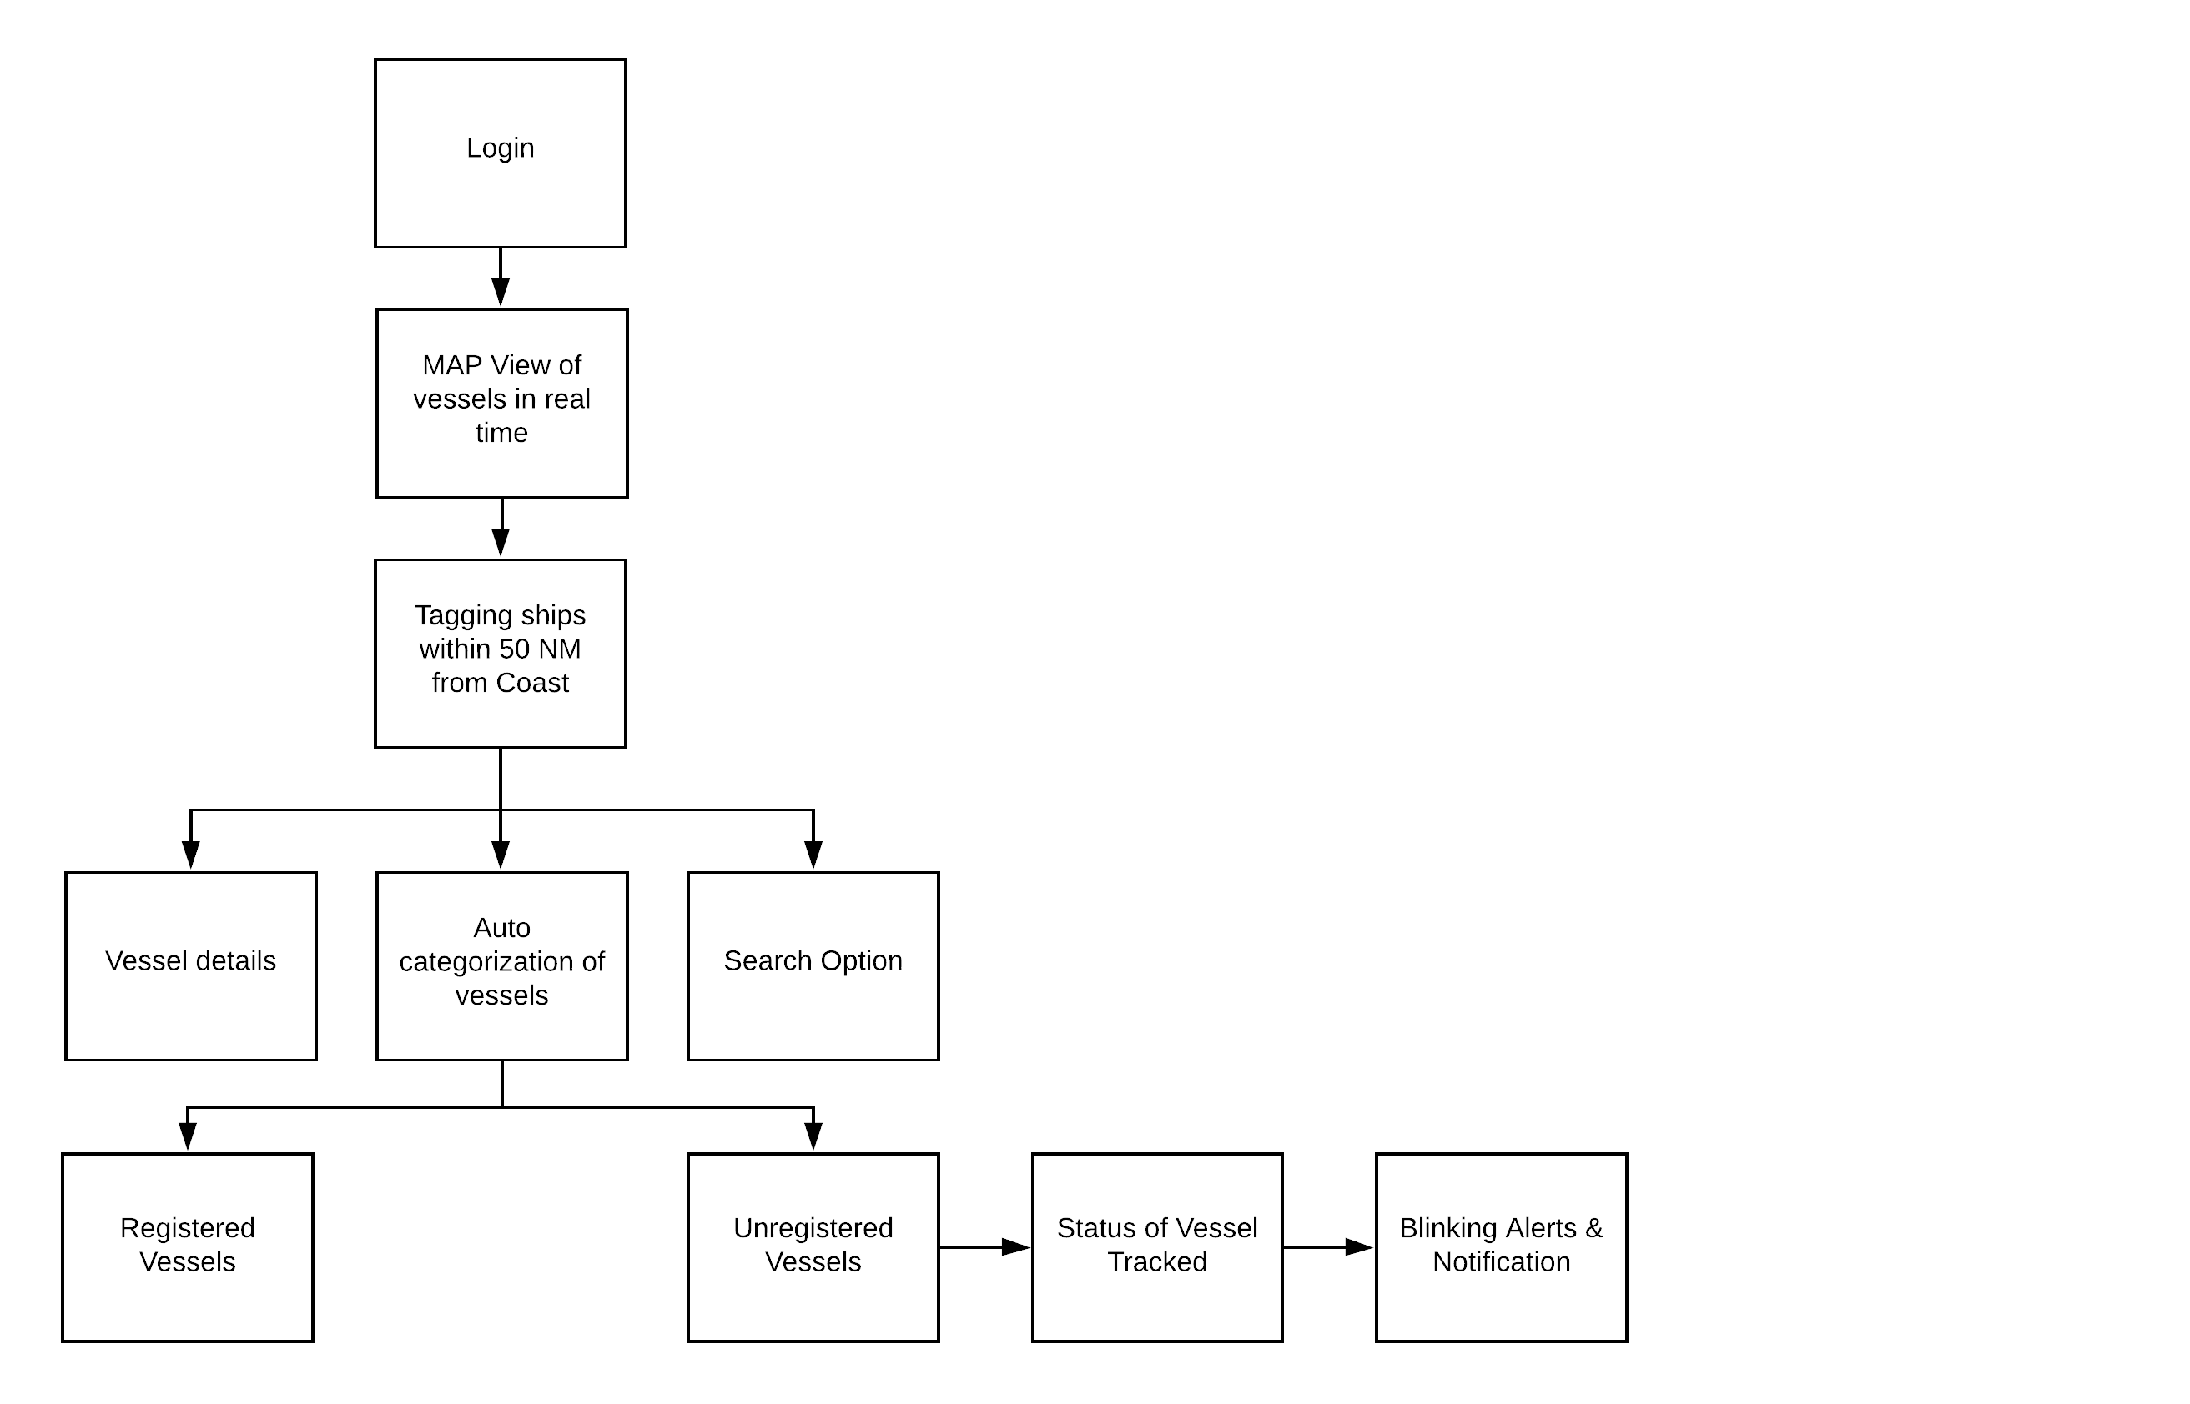
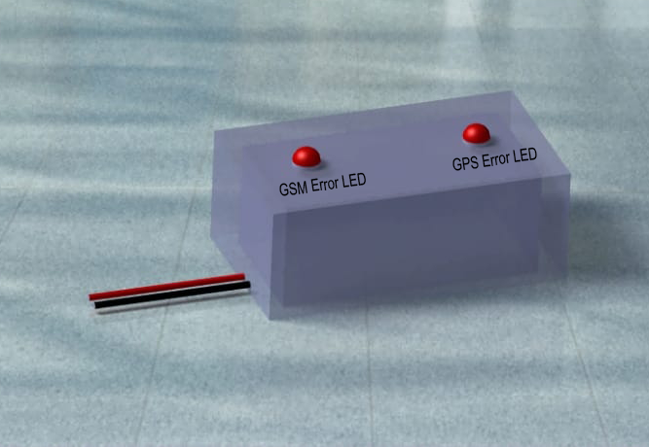
Flow Chart & PCB Enclosure
PCB Enclosure

